Slide 1
Connecticut Data: Implications for Higher Education
Braden J. Hosch, Ph.D.
Connecticut Board of Regents for Higher Education
(August 13, 2013)

Slide 2
Overview
Population change
Population Change, Enrollment, Completions and Educational Attainment
Important Indicators
College Readiness
Student Success
Affordability
Innovation and Economic Development
Equity

Slide 3
Population Change – United States
US Population By Age and Sex, 1900
Men
Women
Data Source: U.S. Census Bureau

Slide 4
Population Change – United States
US Population By Age and Sex, 1950
Men
Women
Data Source: U.S. Census Bureau

Slide 5
Population Change – United States
US Population By Age and Sex, 1980
Men
Women
Data Source: U.S. Census Bureau

Slide 6
Population Change – United States
US Population By Age and Sex, 1990
Men
Women
Data Source: U.S. Census Bureau

Slide 7
Population Change – United States
US Population By Age and Sex, 2000
Men
Women
Data Source: U.S. Census Bureau

Slide 8
Population Change – United States
US Population By Age and Sex, 2010
Men
Women
Data Source: U.S. Census Bureau

Slide 9
Population Change – United States
US Population By Age and Sex, 2020
Men
Women
Data Source: U.S. Census Bureau

Slide 10
Population Change – United States
US Population By Age and Sex, 2030
Men
Women
Data Source: U.S. Census Bureau

Slide 11
Population Change – United States
US Population By Age and Sex, 2040
Men
Women
Data Source: U.S. Census Bureau

Slide 12
Population Change – United States
US Population By Age and Sex, 2050
Men
Women
Data Source: U.S. Census Bureau

Slide 13
Population Change – Connecticut
Connecticut Population By Age and Sex, 1990
Men
Women
Data Source: U.S. Census Bureau

Slide 14
Population Change – Connecticut
Connecticut Population By Age and Sex, 2000
Men
Women
Data Source: U.S. Census Bureau

Slide 15
Population Change – Connecticut
Connecticut Population By Age and Sex, 2010
Men
Women
Data Source: U.S. Census Bureau

Slide 16
Population Change – Connecticut
Connecticut Population By Age and Sex, 2020
Men
Women
Data Source: U.S. Census Bureau

Slide 17
Population Change – Connecticut
Connecticut Population By Age and Sex, 2030
Men
Women
Data Source: U.S. Census Bureau

Slide 18
United States Population Change
 | U.S. Population |  | Change in U.S. Population (from 2010)
 | 20-24 | 70+ | 20-24 | 70+
2010 | 21,779,480 | 27,968,034 | -- | --
2020 | 21,799,193 | 36,943,962 | 19,713 | 8,975,928
2030 | 24,191,409 | 51,711,144 | 2,411,929 | 23,743,110
2040 | 26,408,192 | 62,249,538 | 4,628,712 | 34,281,504
2050 | 28,171,436 | 67,004,446 | 6,391,956 | 39,036,412
Data Source: U.S. Census Bureau

Slide 19
Connecticut Population Change
 | Connecticut Population |  | Change in CT Population (from 2010)
 | 20-24 | 70+ | 20-24 | 70+
2010 | 233,040 | 369,177 | -- | --
2020 | 215,023 | 457,048 | -18,017 | 87,871
2030 | 198,927 | 585,871 | -34,113 | 216,694
Data Source: U.S. Census Bureau

Slide 20
Connecticut Population Age 0 and Age 85+ from 1990 to 2011
Source: U.S. Census, Intercensal estimates, 1980-89, 1990-1999, 2000-2010 , 2011
Notes:
1990-99: icen_stA1.txt
2000-10: ST-EST00INT-AGESEX
2011: SC-EST2011-AGESEX-RES.csv

Slide 21
Implications of Population Change
Shift in budget priorities from education to health care
Shift in mission of higher education to provide continuing education throughout the lifespan

Slide 22
CT Public High School Graduates 1970-2023

Slide 23
CT Undergraduate Fall Headcount

Slide 24
CT Undergraduate Fall Headcount Enrollment & HS Graduates

Slide 25
CT Undergraduate Fall Headcount Enrollment & HS Graduates (+3 Years)

Slide 26
CT Undergraduate Fall Headcount Enrollment (Full-time & Part-time)

Slide 27
CT Undergraduate FTE Enrollment

Slide 28
CT Undergraduate FTE Enrollment & Completions
* Undergraduate certificates counted as 1/3 completion

Slide 29
CT Undergraduate FTE Enrollment & Completions (-2 years)
* Undergraduate certificates counted as 1/3 completion

Slide 30
CT Educational Attainment, Ages 25-44
 | Pop. 25 to 44 years
Educational Attainment | N | Pct
Less than 9th grade | 26,524 | 3.0
9th to 12th grade, no diploma | 53,218 | 5.9
High school graduate, GED, or alternative | 217,326 | 24.3
Some college, no degree | 171,999 | 19.2
Associate's degree | 68,097 | 7.6
Bachelor's degree | 217,284 | 24.3
Graduate or professional degree | 140,685 | 15.7
Total | 895,133 | 100.0
Attained Associate's Degree or Higher | 426,066 | 47.6
At least HS diploma, no college degree | 389,325 | 43.5
Source: U.S. Census, American Community Survey, 2011, 1-Year Est.

Slide 31
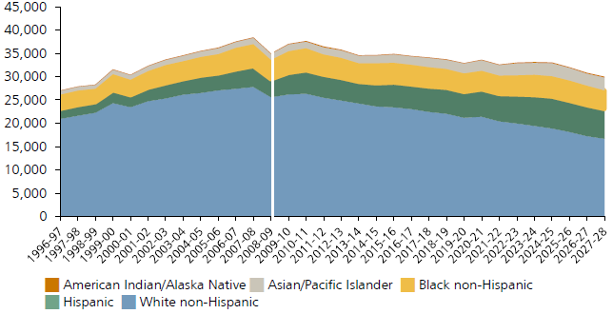
CT High School Graduates by Race/Ethnicity
Source: Knocking at the College Door (WICHE, 2012)

Slide 32
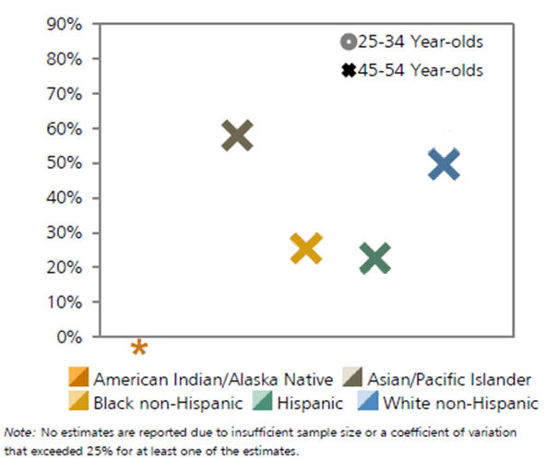
CT Educational Attainment by Race/Ethnicity
Pct Associate’s or Higher
Source: Knocking at the College Door (WICHE, 2012)

Slide 33
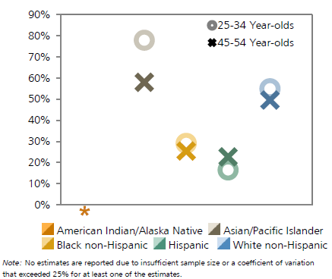
CT Educational Attainment by Race/Ethnicity
Pct Associate’s or Higher
Source: Knocking at the College Door (WICHE, 2012)

Slide 34
Undergraduate Completions by Race/Ethnicity
*** Race/ethnicity collection and reporting changed in 2010. Subsequent data may not be comparable; interpret with caution
Notes:
Source: Connecticut Database for IPEDS Completions Reporting

Slide 35
Graduate Student Enrollment

Slide 36
Graduate Student Enrollment

Slide 37
Graduate Degree Completions

Slide 38
College Readiness CT Community Colleges
Source: Complete College America, Time Is the Enemy (2011). Comparison data are from entering students in 2006; CT data are from entering students in 2008 reported to CCA in 2013..

Slide 39
Student Success -Time to Degree CT Public Institutions
Award/Entry Status | Average Years | State Rank
Certificate-Seeking
Full-Time | 3.4 | 14 out of 26
Part-Time | 5.0 | 18 out of 26
Associate’s-Seeking
Full-Time | 4.3 | 19 out of 28
Part-Time | 5.6 | 18 out of 28
Bachelor’s-Seeking
Full-Time | 4.4* | 7 out of 29*
Part-Time | 5.2* | 8 out of 29*
Source: Complete College America, Time Is the Enemy (2011). Comparison data are from completions in 2007-08; CT data are from 2010-11 completions reported to CCA in 2013.
*Because Connecticut does not capture unit records at the state level for public higher education, these figures may not reflect all credits earned.

Slide 40
Student Success - Credits to Degree CT Public Institutions
Award/Entry Status | Average Credits | State Rank
Certificate-Seeking
Full-Time | 77 | 21 out of 25
Part-Time | 70 | 21 out of 25
Associate’s-Seeking
Full-Time | 84 | 16 out of 28
Part-Time | 85 | 19 out of 28
Bachelor’s-Seeking
Full-Time | 125* | 2 out of 29*
Part-Time | 115* | 2 out of 28*
Source: Complete College America, Time Is the Enemy (2011). Comparison data are from completions in 2007-08; CT data are from 2010-11 completions reported to CCA in 2013.
*Because Connecticut does not capture unit records at the state level for public higher education, these figures may not reflect all credits earned.

Slide 41
Affordability – Student Charges

Slide 42
State Appropriations & Tuition Revenue per FTE, United States, Constant Dollars
Source: SHEEO, State Higher Education Finance Report, FY12. Inflation adjusted by Higher Education Cost Index (HECA)

Slide 43
State Appropriations & Tuition Revenue per FTE, Connecticut, Constant Dollars
Source: SHEEO, State Higher Education Finance Report, FY12. Inflation adjusted by Higher Education Cost Adjustment (HECA)

Slide 44
Distance Learning

Slide 45
Distance Learning

Slide 46
Closing Observations
Fewer 18-24 year olds →
Increased competition
Shift to serving older students
Downward pressure on revenues
Historical patterns of success will not meet attainment goals (Obama Administration, Lumina)
Contextual Opportunities
College Readiness
Student Success
Affordability / sustainable financing model
Innovative models for learning & teaching
Equity in outcomes

